Slide 1
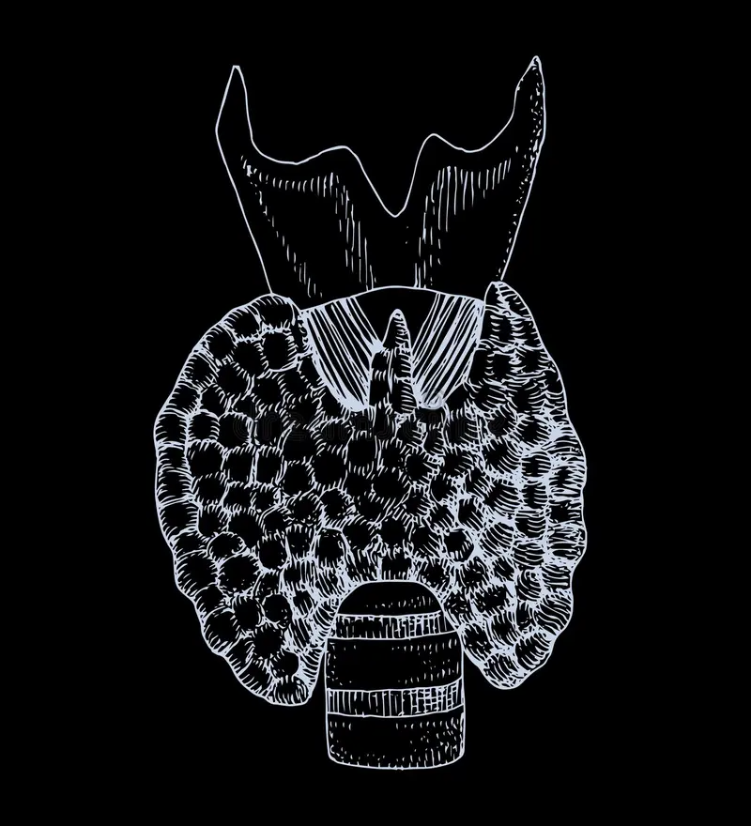
The Thyroid Gland: More Than Just a Butterfly
Gross Anatomy, Histology, Clinical Pearls & Interdisciplinary Integration
N. Prabhav (118)
Notes:
Today, we’ll explore the thyroid gland—its structure, function, clinical impact, and how it integrates with physiology and biochemistry.

Slide 2
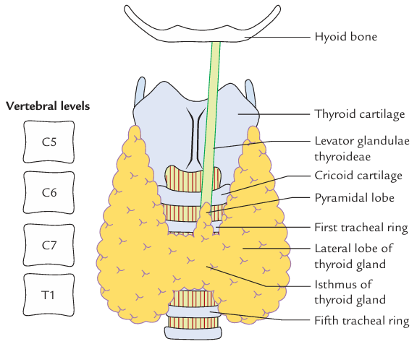
Introduction
Butterfly-shaped endocrine gland in anterior neck
Crucial for metabolic regulation, development, and calcium balance
Often underestimated... until it misbehaves
Notes:
The thyroid regulates metabolism, growth, and calcium. It sits quietly until something goes wrong, then all hell breaks loose.

Slide 3
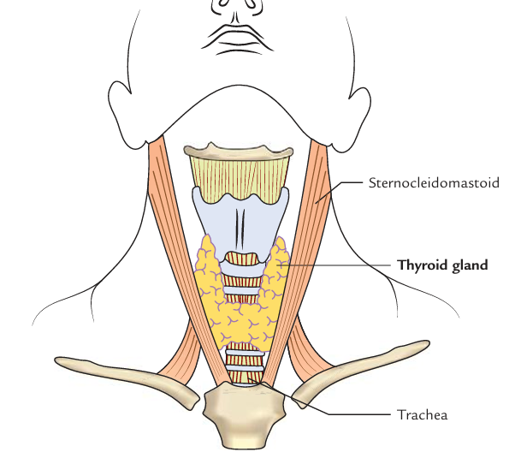
Gross Anatomy
Location: C5–T1, below larynx, over trachea
Lobes: Two lateral + isthmus ± pyramidal lobe
Dimensions: ~20–30g; larger in females/pregnancy
Vascular supply: Sup. & inf. thyroid arteries; thyroid IMA (rare)
Relations: Strap muscles, trachea, carotid sheath
Notes:
It’s like a butterfly hugging your trachea. Richly vascular and dangerously close to critical nerves.

Slide 4
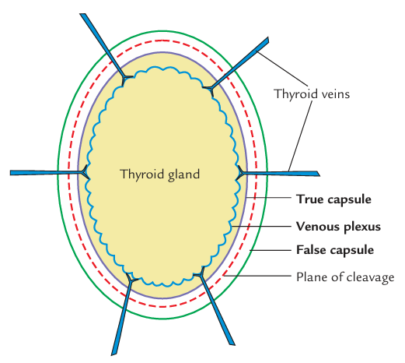
Gross Anatomy - Capsules

Slide 5
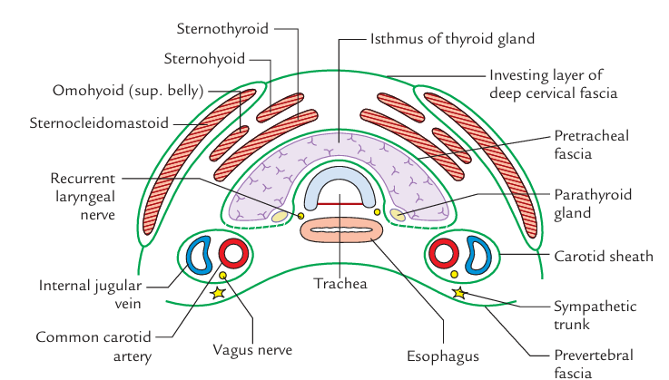
Gross Anatomy - T.S. Section

Slide 6
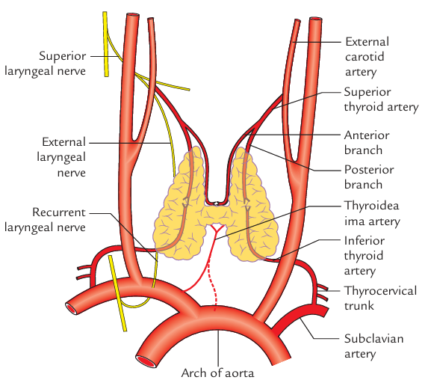
Gross Anatomy - Arterial Supply

Slide 7
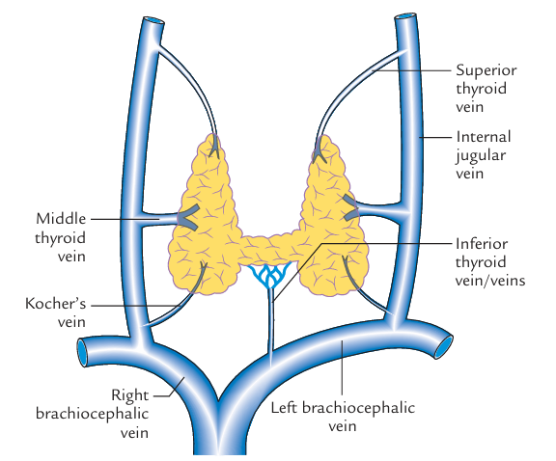
Gross Anatomy - Venous Drainage

Slide 8
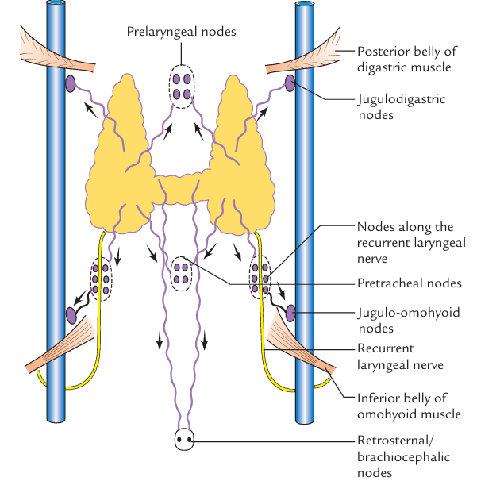
Gross Anatomy - Lymphatic Drainage

Slide 9
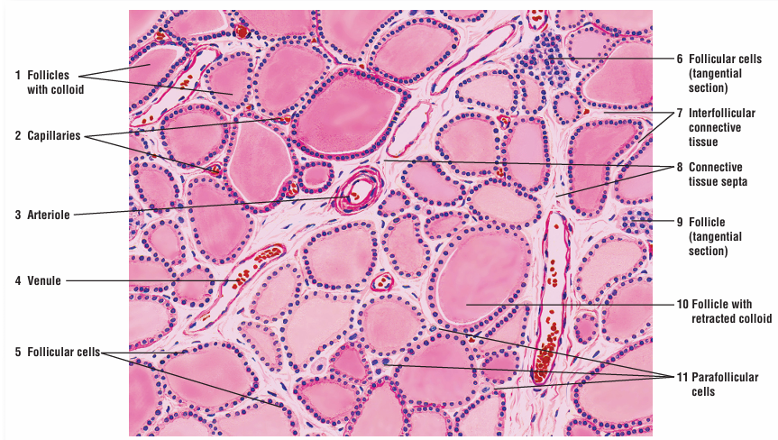
Histology
Follicles: Lined by cuboidal cells; filled with colloid (thyroglobulin)
Colloid: Stores thyroid hormones extracellularly (unique!)
C cells: Secrete calcitonin; parafollicular, pale-staining
Activity changes shape: Resting = low cuboidal; active = tall columnar
Notes:
Thyroid follicles are like hormone-filled jelly balls. C-cells are the quieter calcium moderators.

Slide 10

Histology

Slide 11
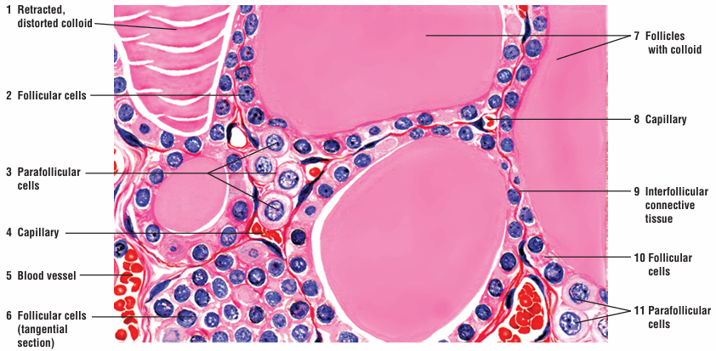
Histology

Slide 12
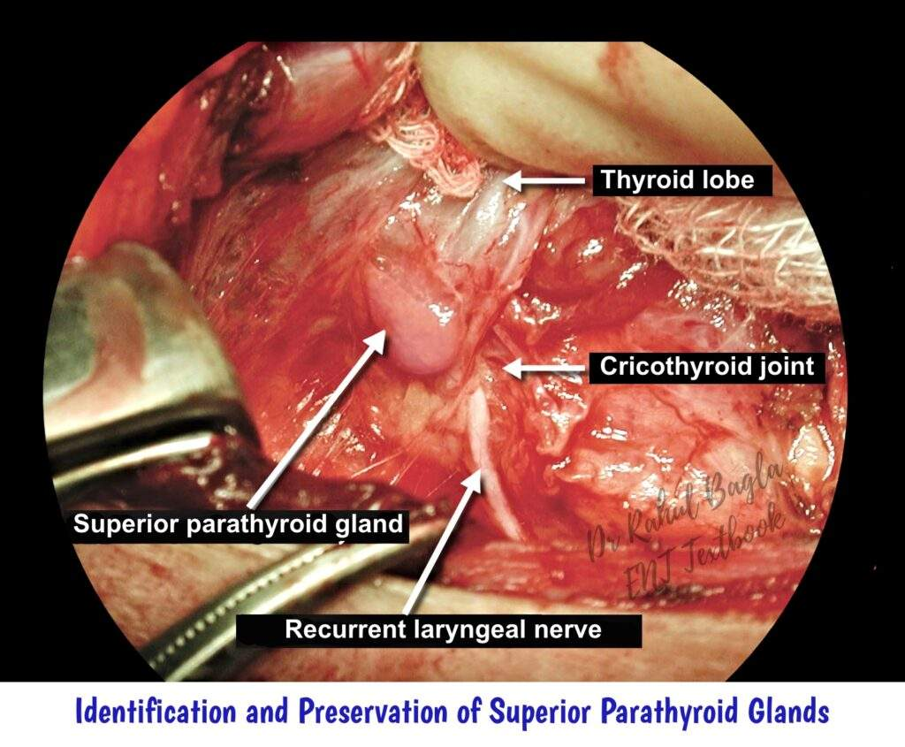
Surgical Anatomy
Recurrent laryngeal nerve (RLN): Behind gland, at risk during surgery
External laryngeal nerve: High-pitched voice control
Parathyroids: Posterior surface; preserve during thyroidectomy
Capsule: True vs. false; deep capillary plexus under true capsule
Notes:
Surgeons walk a tightrope here—snip the wrong nerve and your patient may sound like Darth Vader.

Slide 13
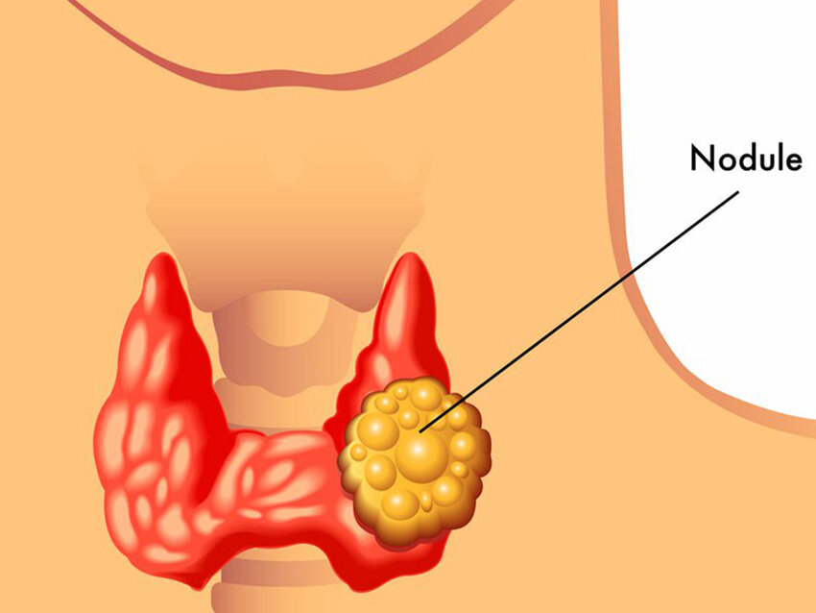
Clinical Significance
Thyroid nodules: Common, mostly benign
Thyroidectomy: Nerve preservation essential
Radiological ‘hot’ vs. ‘cold’ nodules
Notes:
Diagnosing thyroid issues is detective work—hot or cold nodules, benign or bad news.

Slide 14
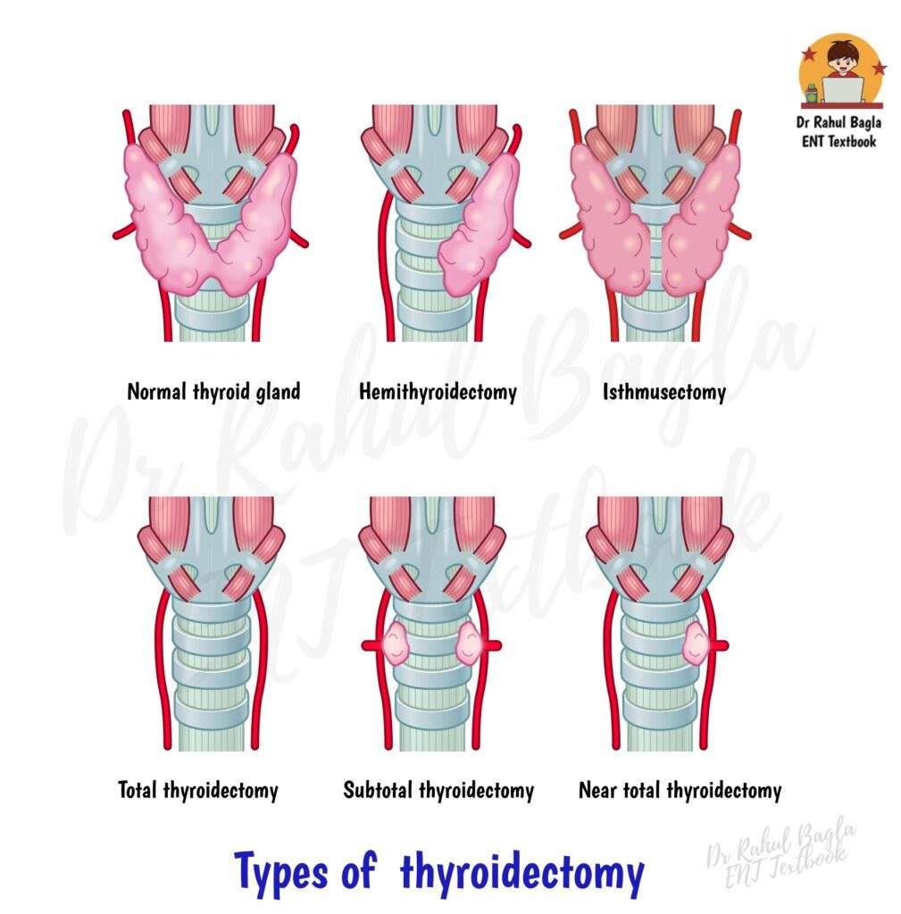
Clinical Significance

Slide 15
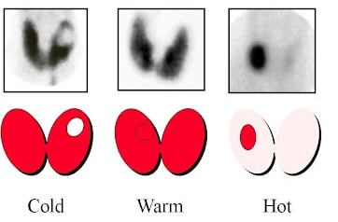
Clinical Significance

Slide 16
Thyroid Disorders
Hypothyroidism: Hashimoto’s; ↑TSH ↓T4
Hyperthyroidism: Graves’, toxic nodules; ↓TSH ↑T4
Goiter: Iodine deficiency, nodular, diffuse
Cancer: Papillary > Follicular > Medullary > Anaplastic
Notes:
When thyroids misbehave: too little makes you slow, too much makes you manic. And cancers range from harmless to horrific.

Slide 17
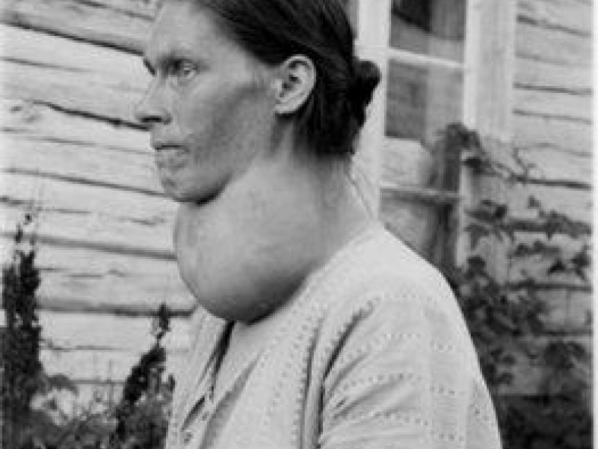
Thyroid Disorders - Goiter

Slide 18
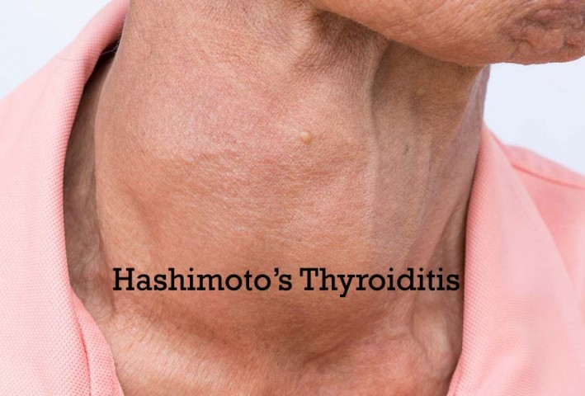
Thyroid Disorders - H.T.

Slide 19
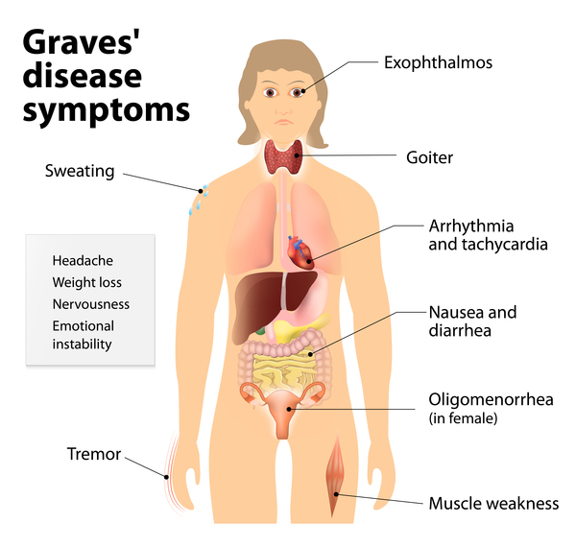
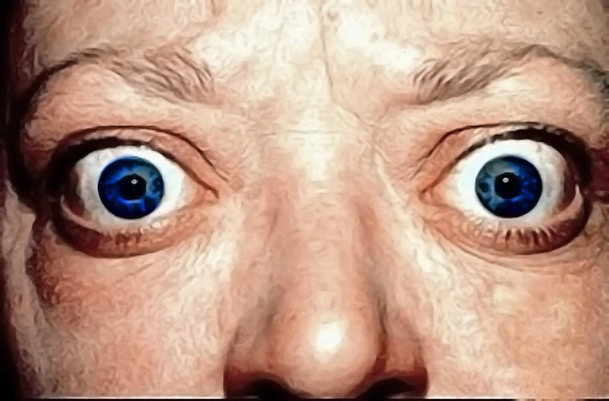
Thyroid Disorders - G.D.

Slide 20
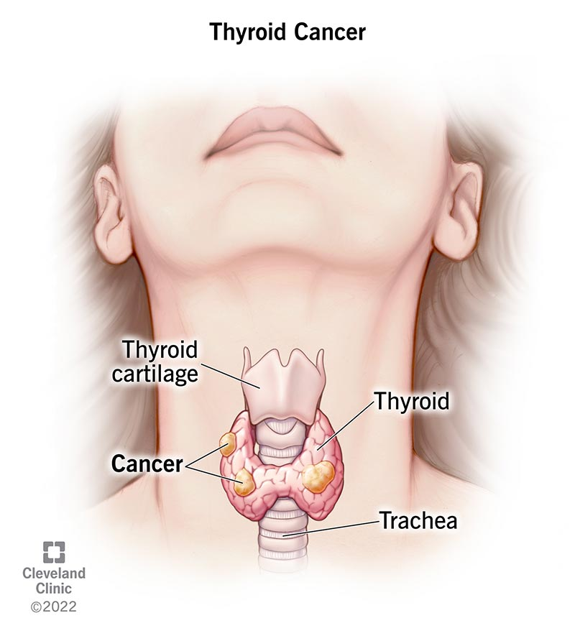
Thyroid Disorders - Thyroid Cancer

Slide 21
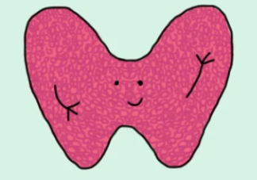
Thank You
Questions? Complaints? Sudden urge to dramatically exit the classroom?
Notes:
Thank you for your attention. Happy to take any questions or comments.

Slide 22
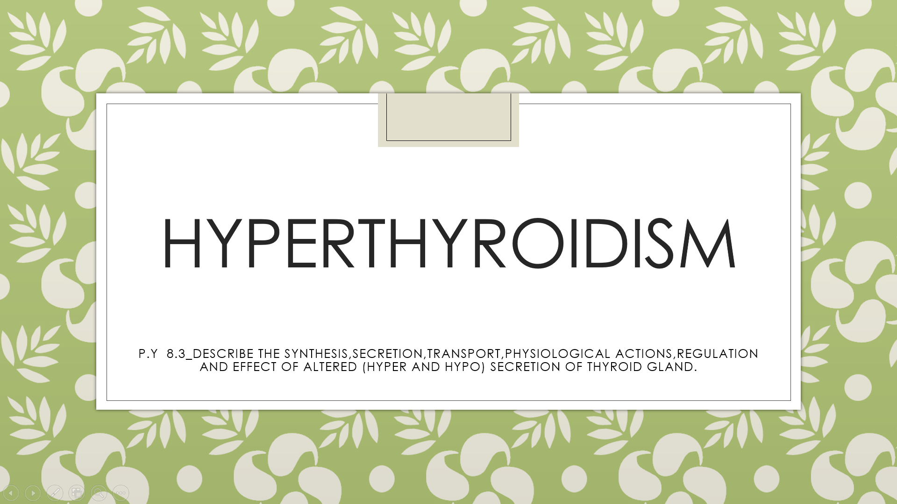

Slide 23
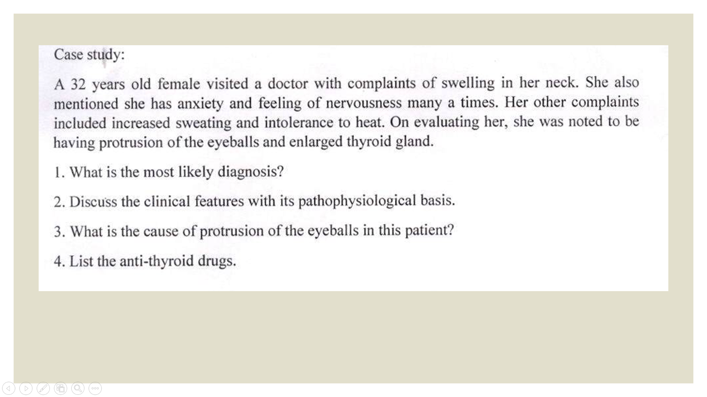

Slide 24
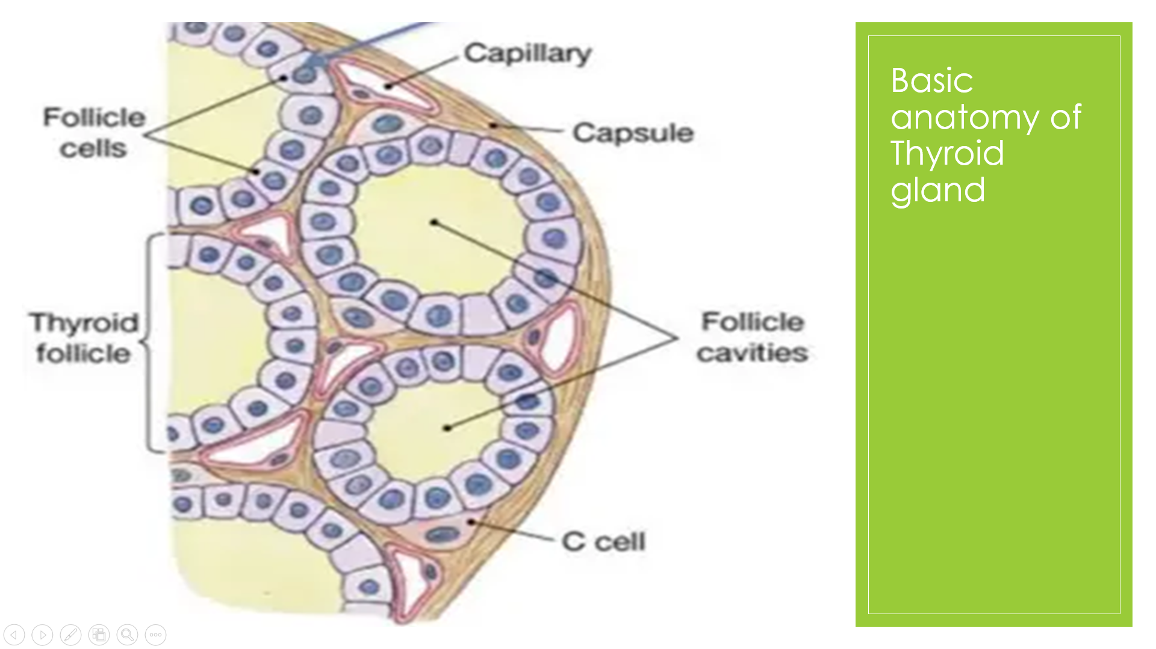

Slide 25
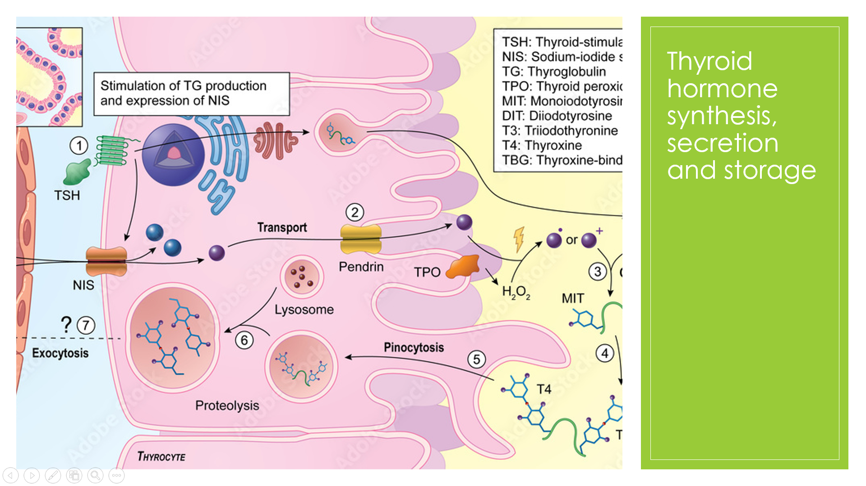

Slide 26
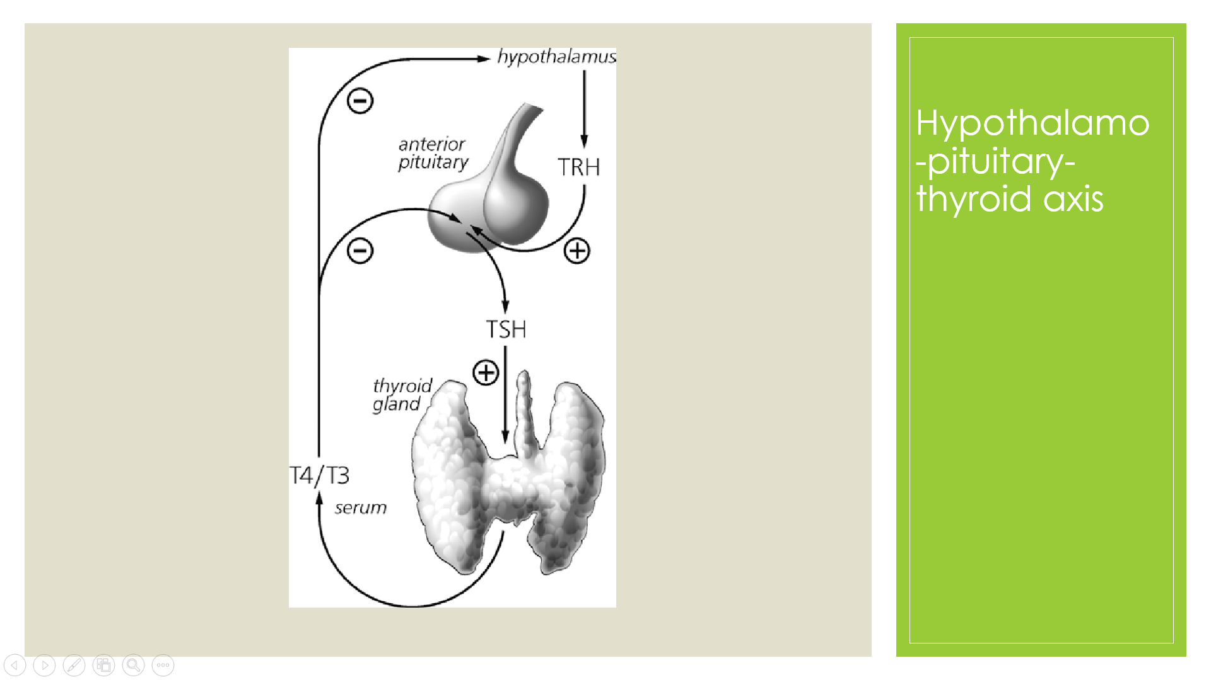

Slide 27
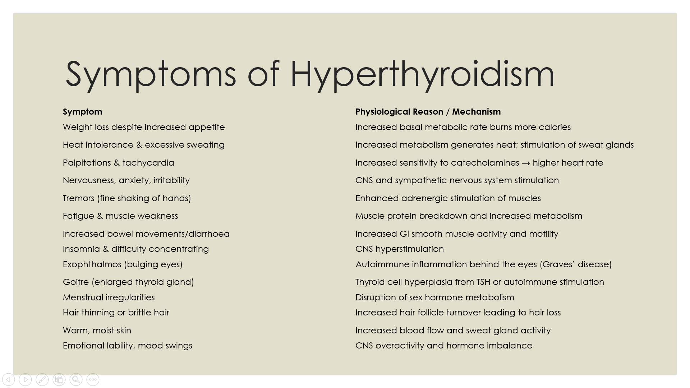

Slide 28
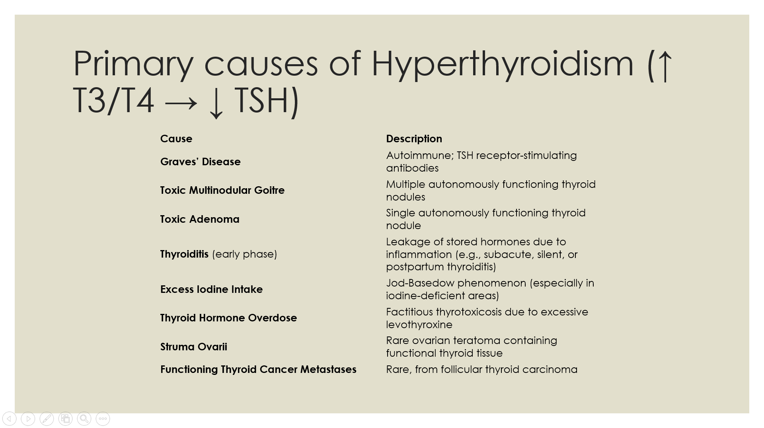

Slide 29
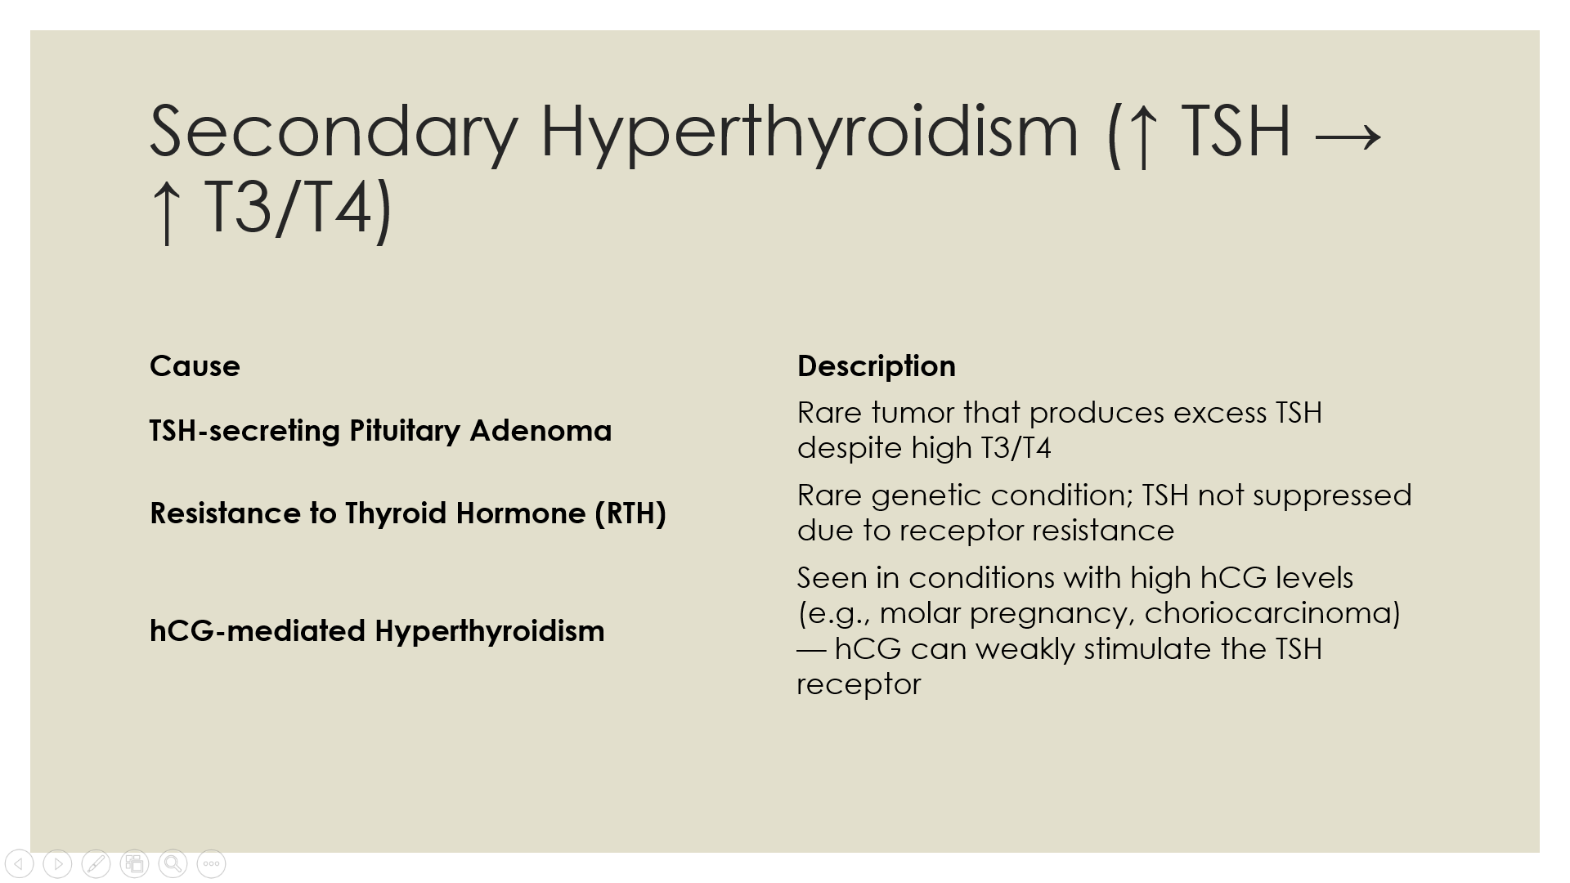

Slide 30
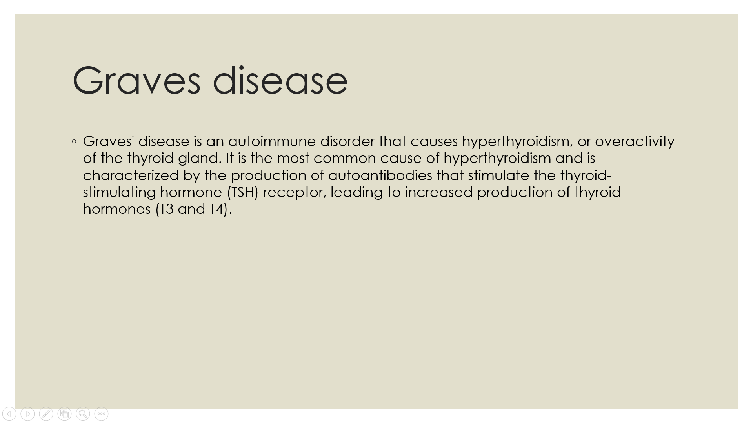

Slide 31
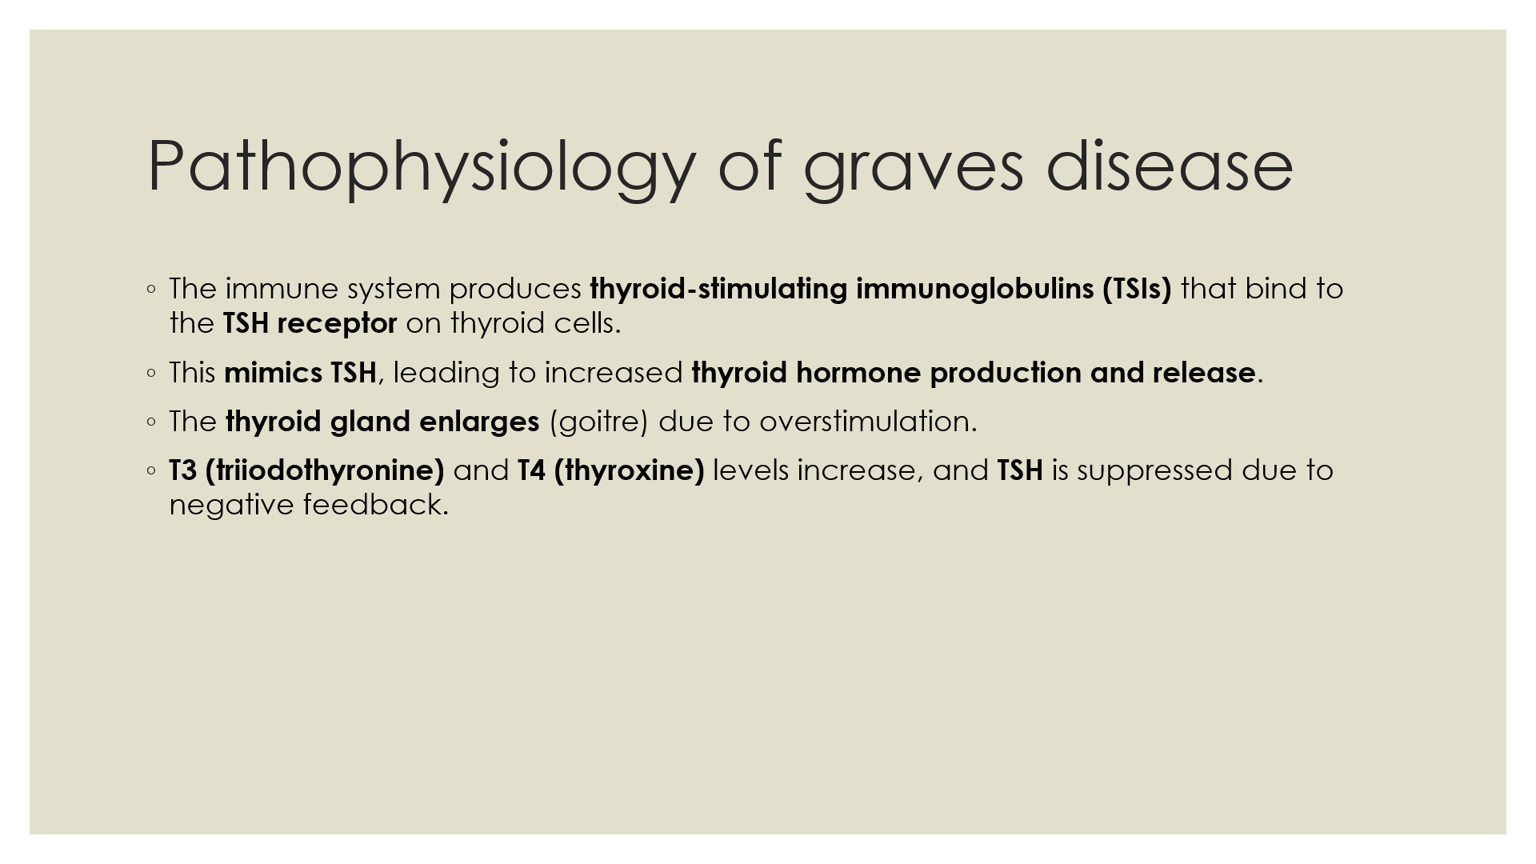

Slide 32
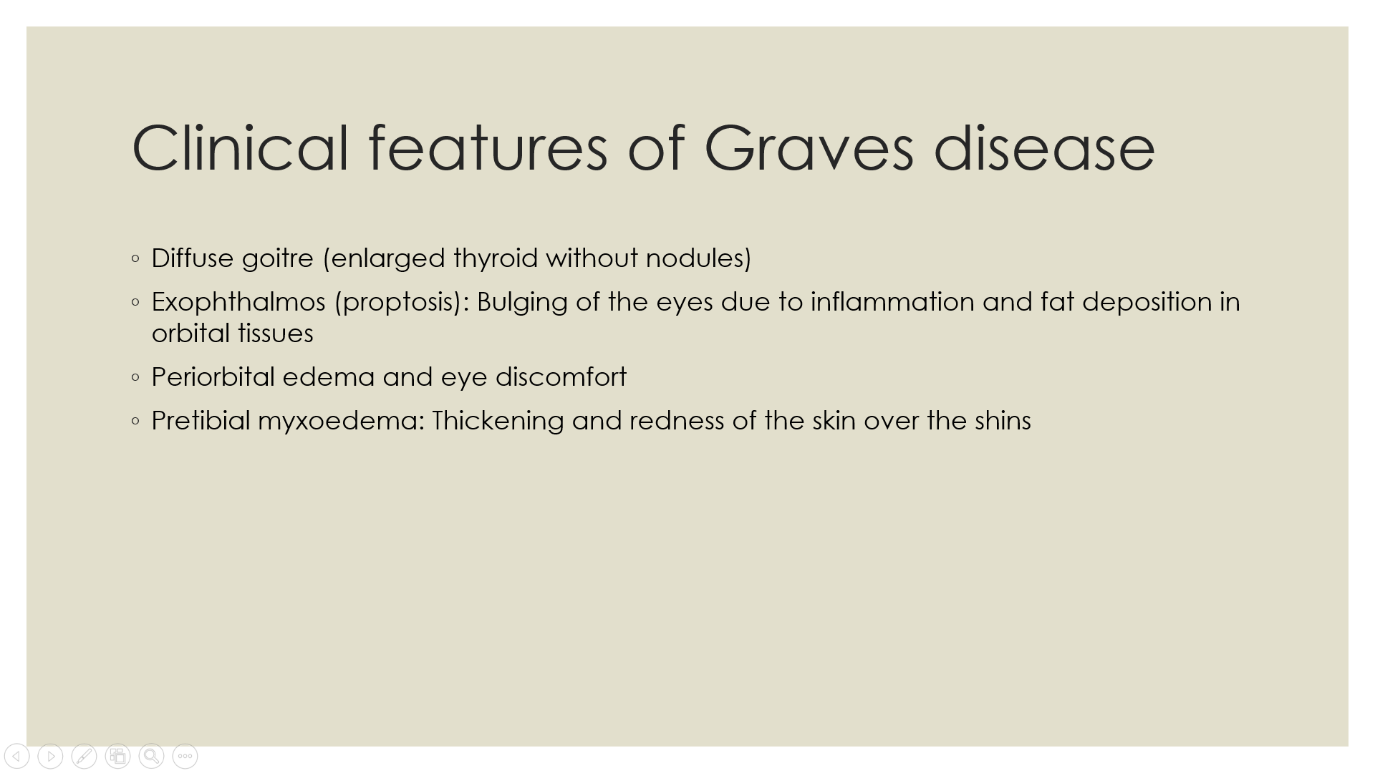

Slide 33
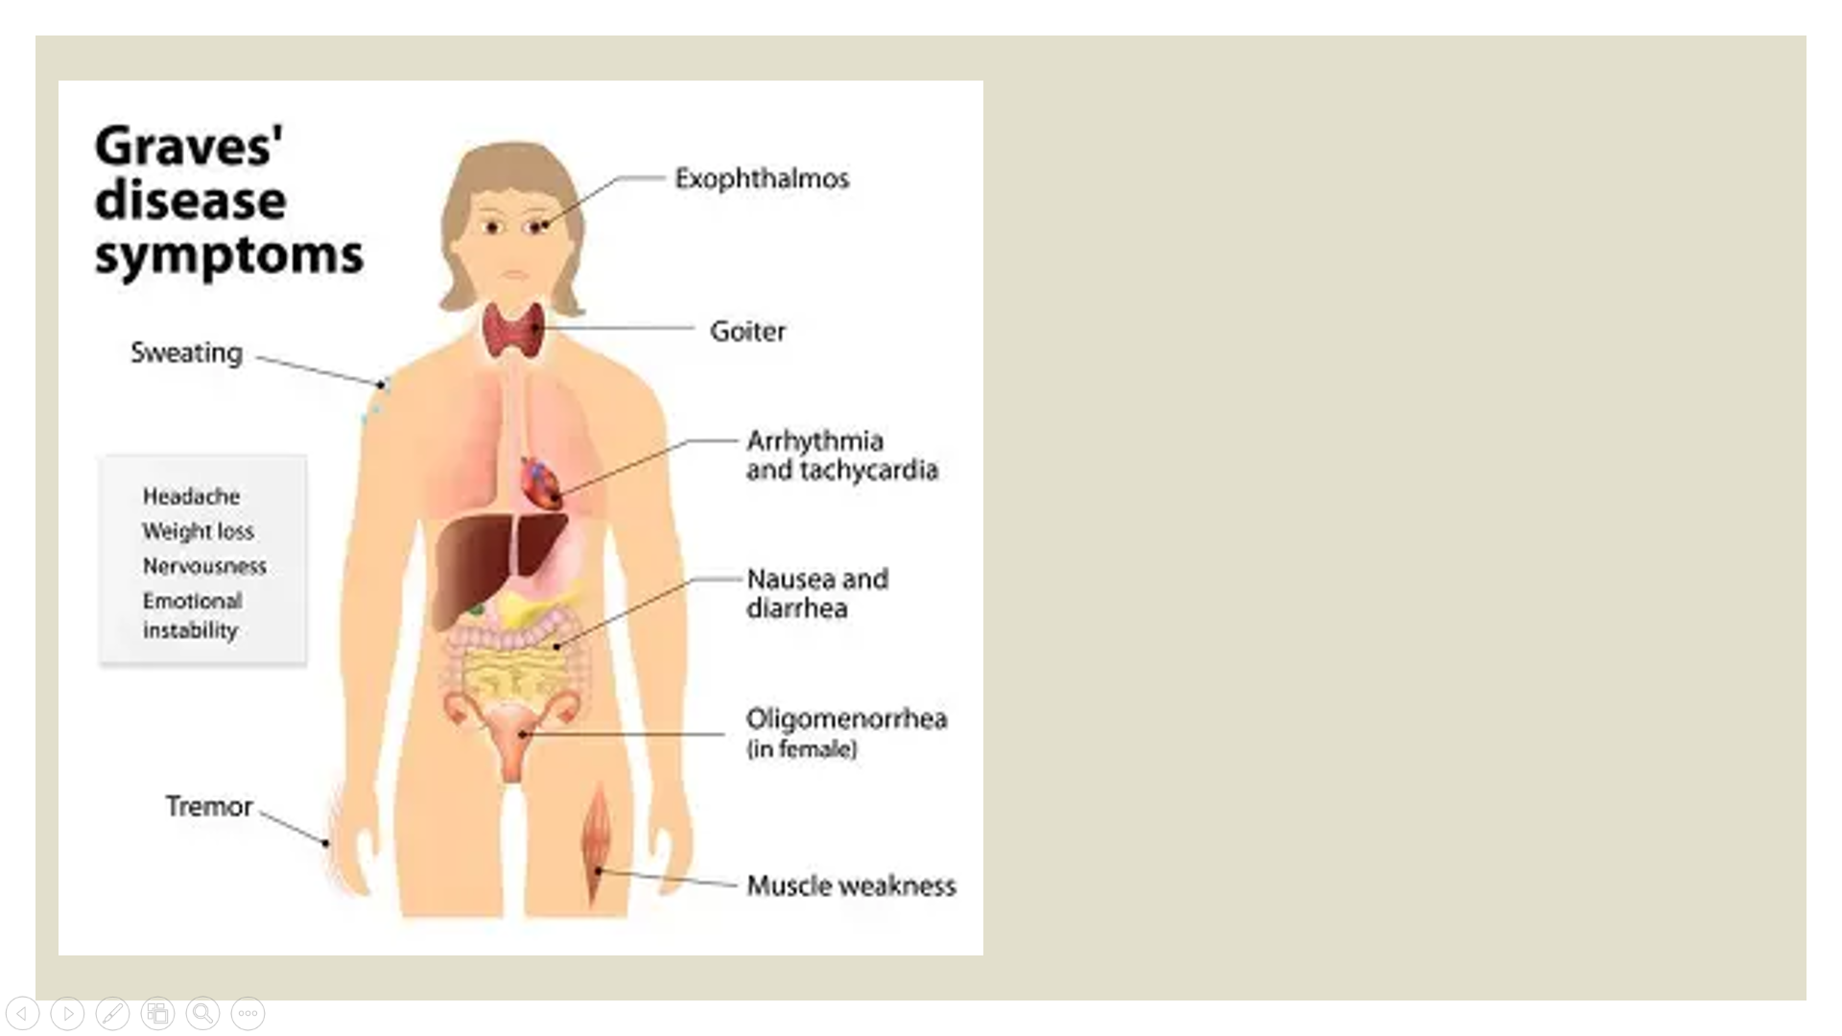

Slide 34
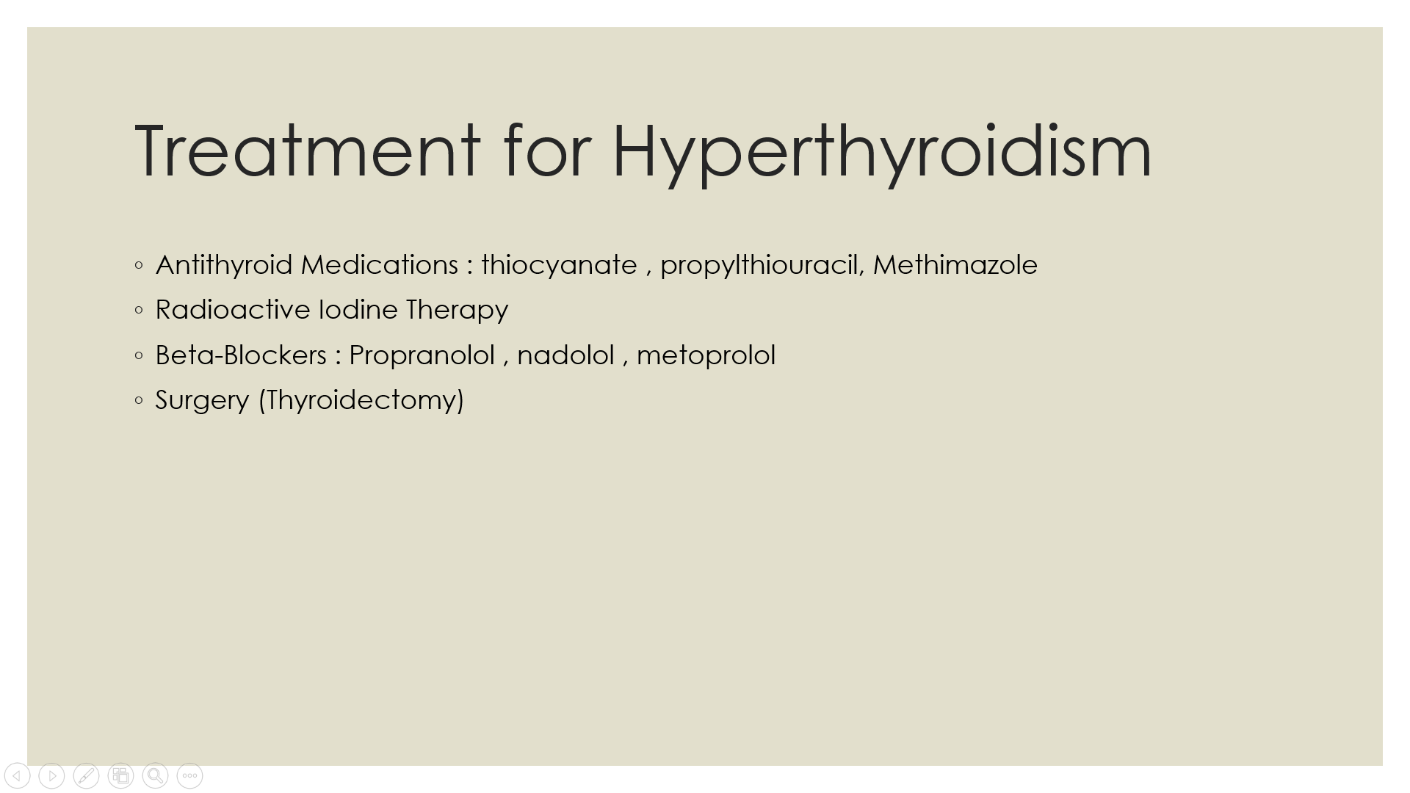

Slide 35
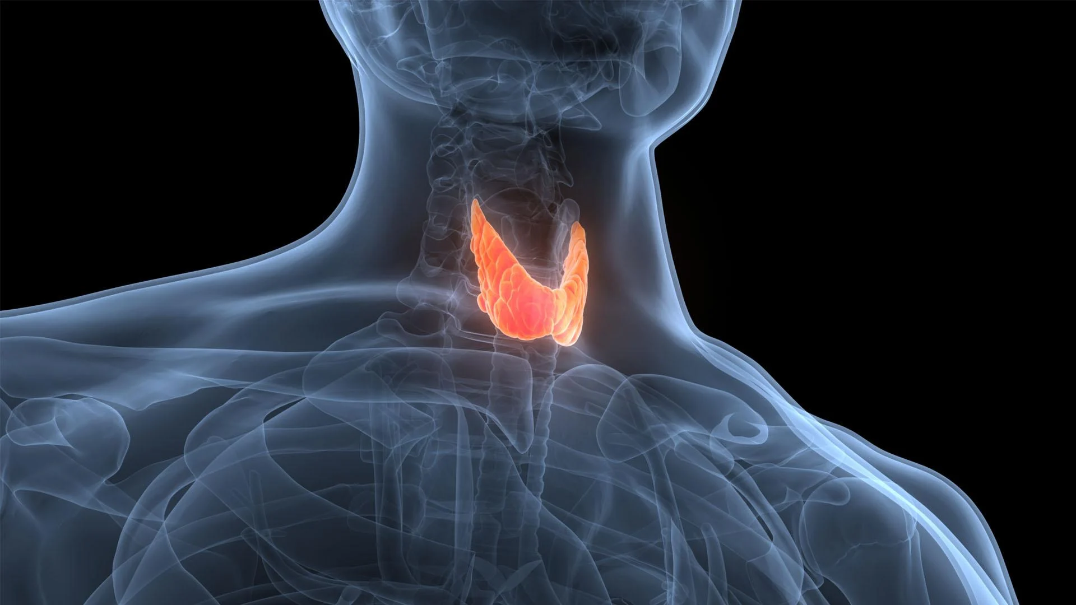
BIOCHEMISTRY

Slide 36
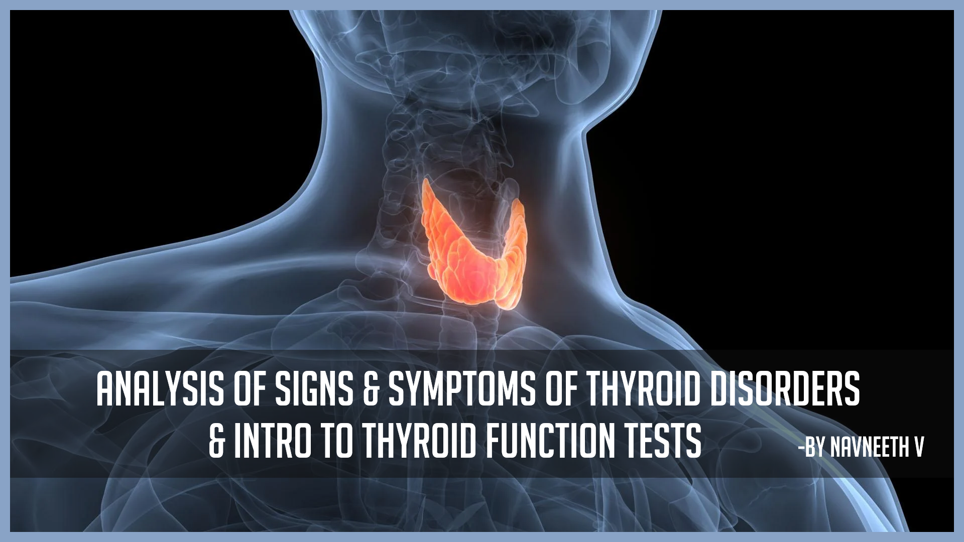
ANALYSIS OF signs & SYMPTOMS OF THYROID DISORDERS
& intro to Thyroid Function Tests
-BY NAVNEETH V

Slide 37
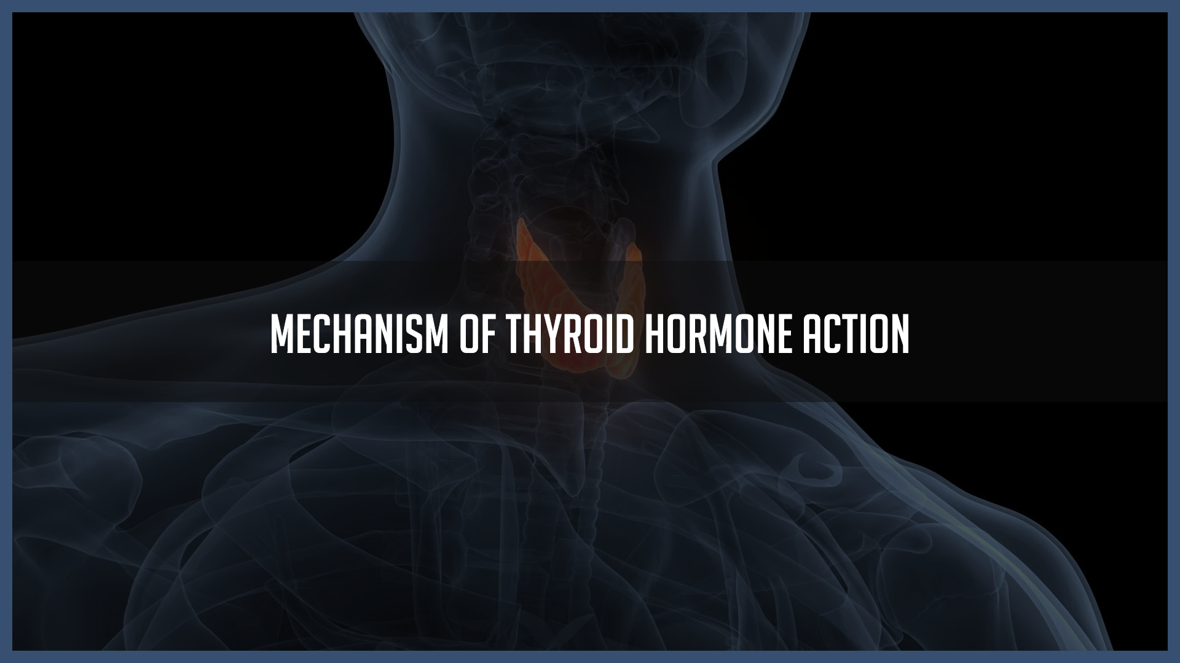
Mechanism of thyroid hormone action

Slide 38
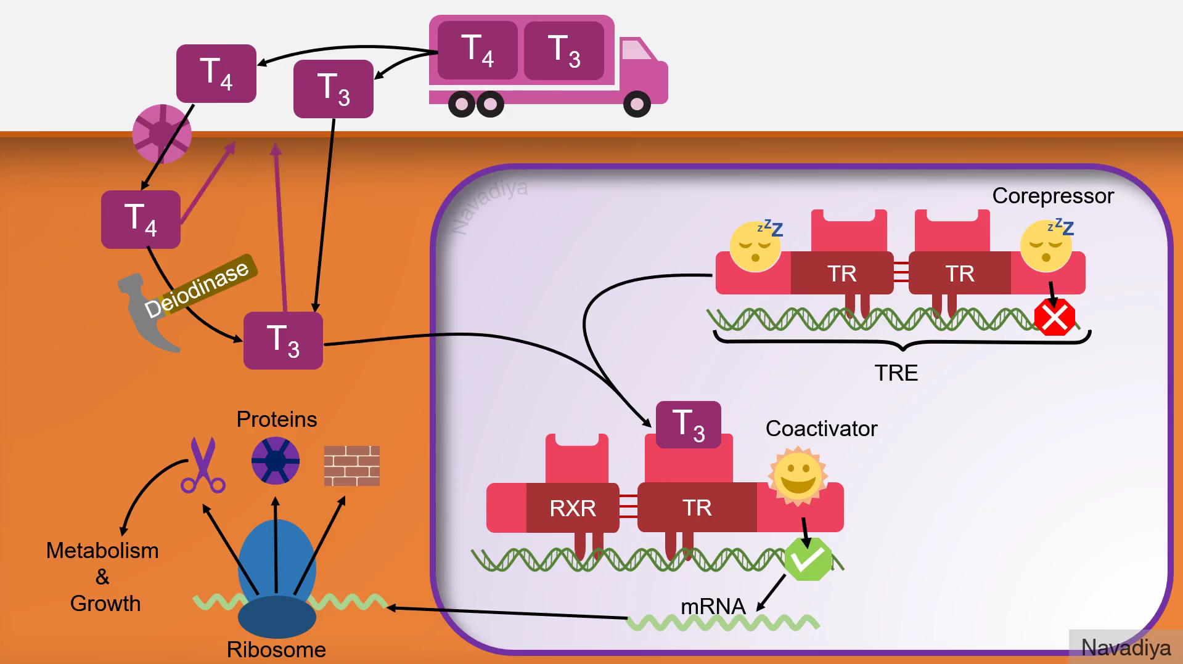

Slide 39
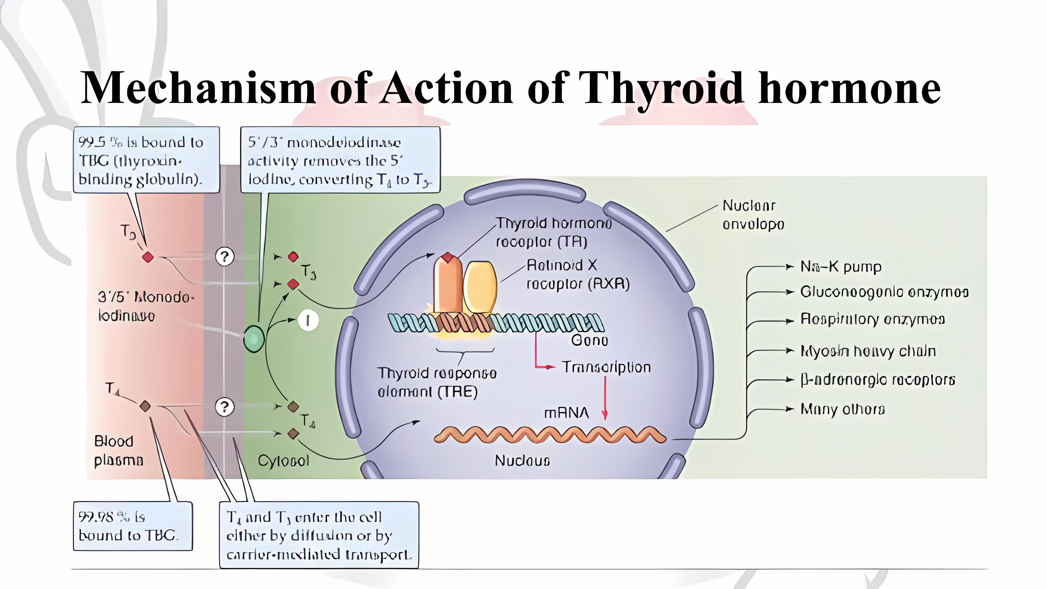
Yes! It’s AI upscaled!

Slide 40
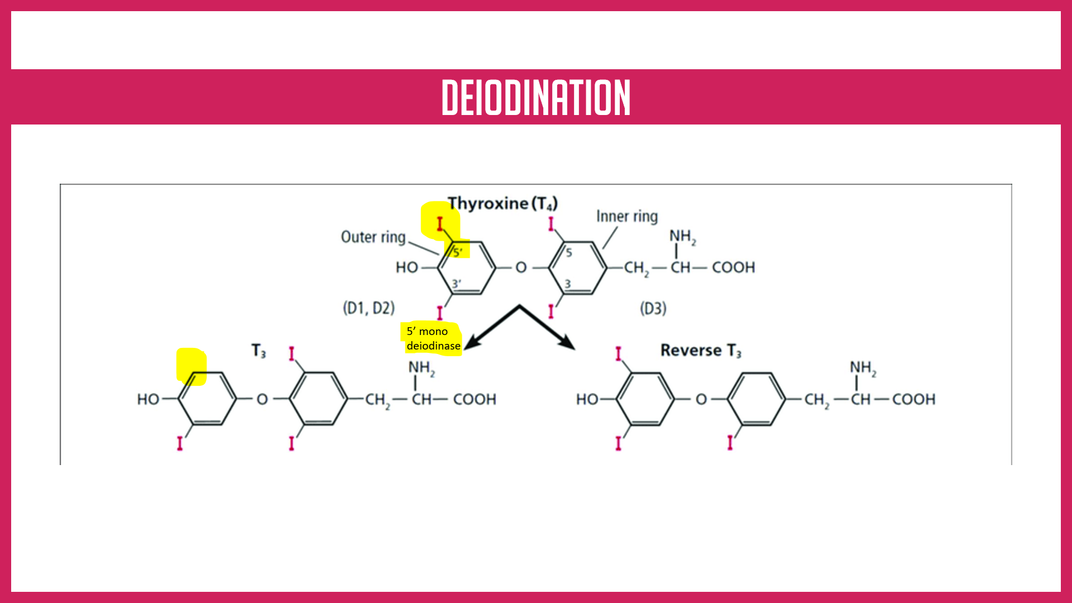
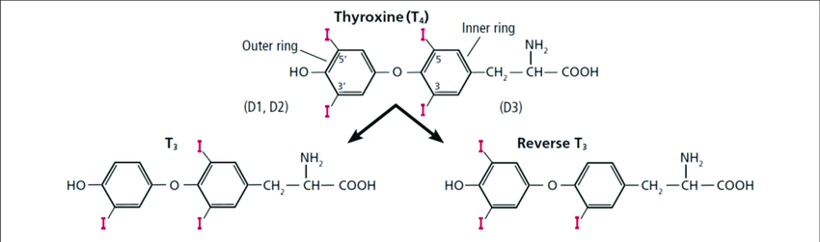




DEiodination
5’ mono deiodinase

Slide 41
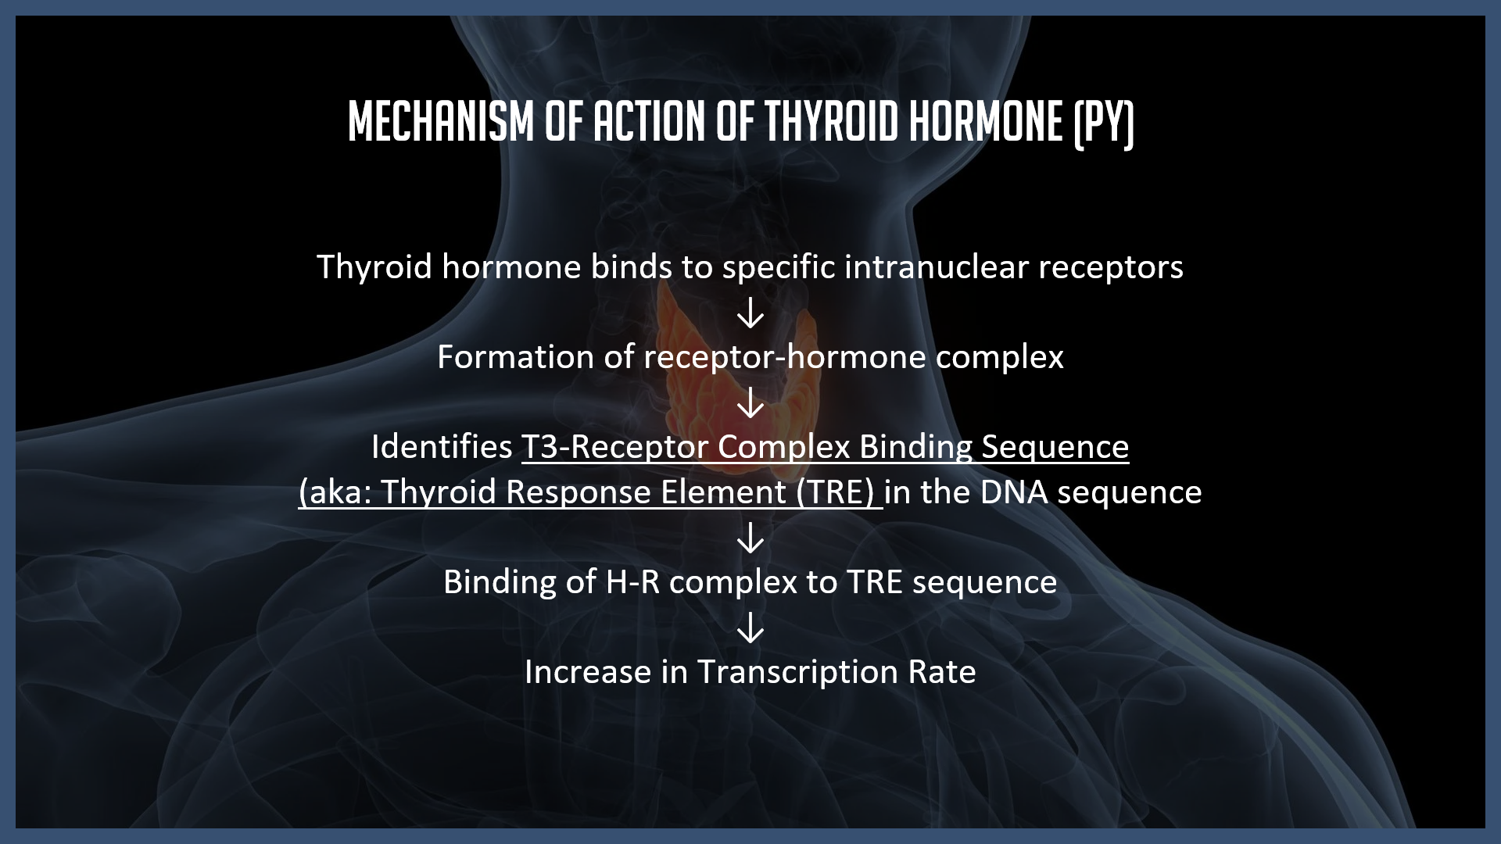
Mechanism of action of thyroid hormone (py)
Thyroid hormone binds to specific intranuclear receptors
↓
Formation of receptor-hormone complex
↓
Identifies T3-Receptor Complex Binding Sequence (aka: Thyroid Response Element (TRE) in the DNA sequence
↓
Binding of H-R complex to TRE sequence
↓
Increase in Transcription Rate

Slide 42
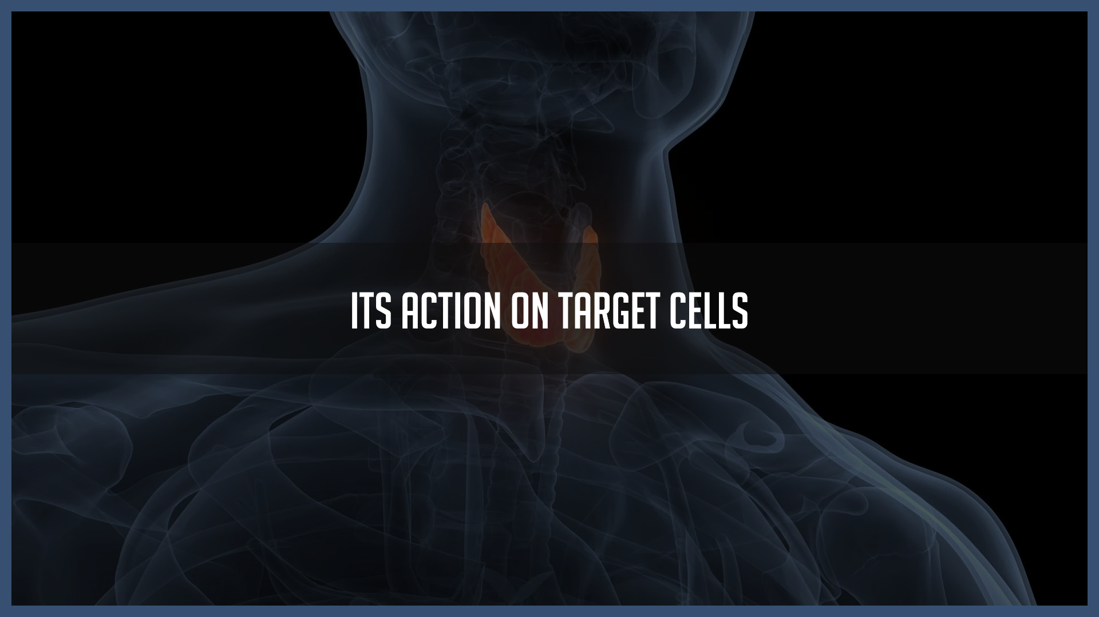
Its Action on target cells

Slide 43
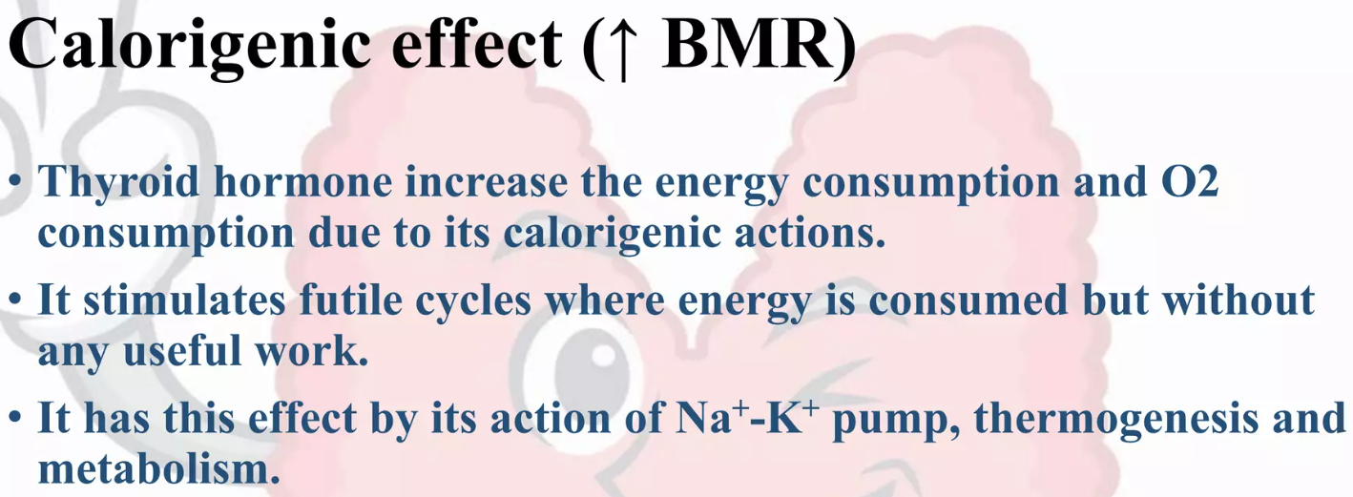
(1)
(2)
(3)

Slide 44
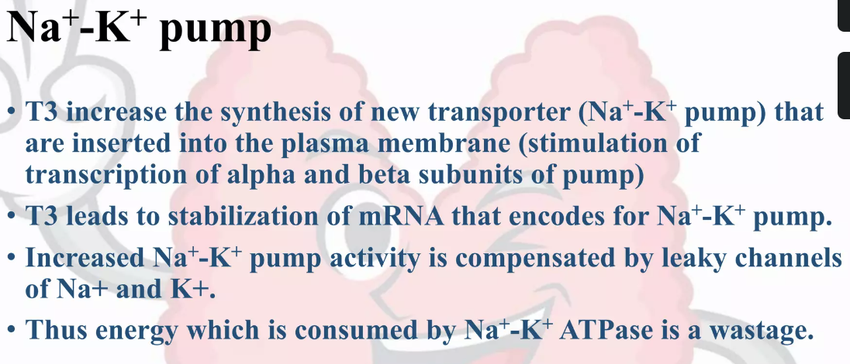
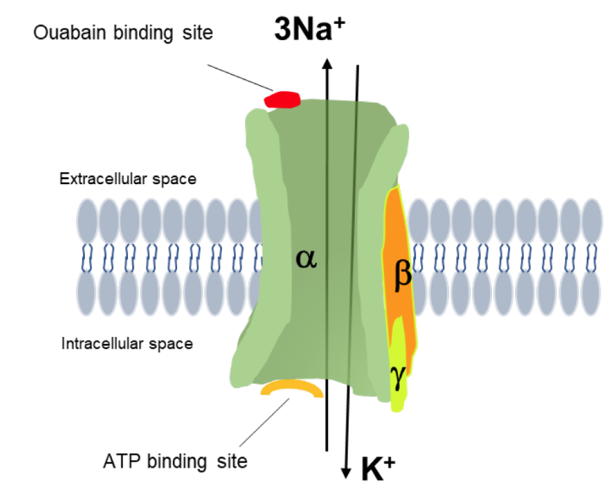





Slide 45
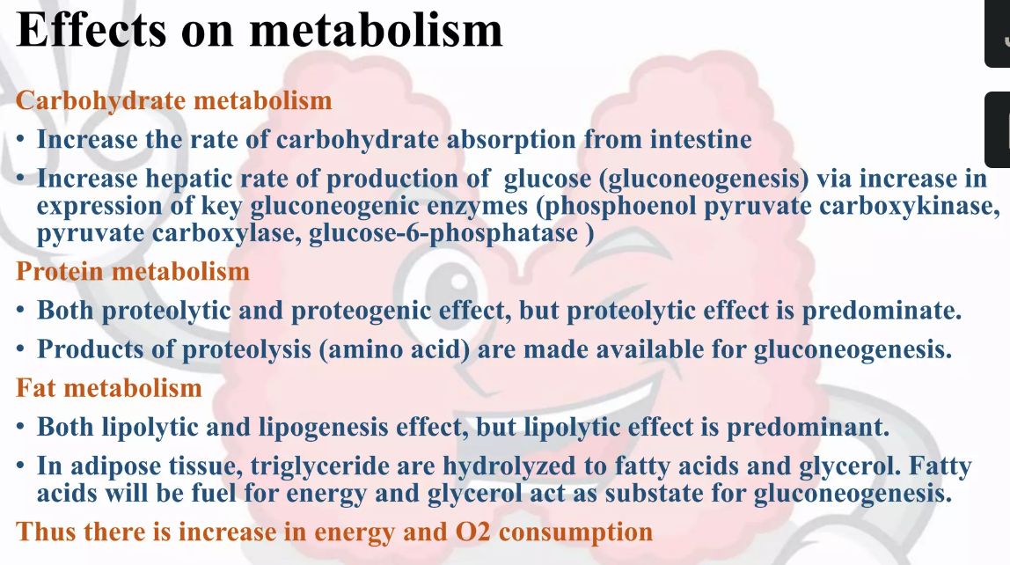


Slide 46
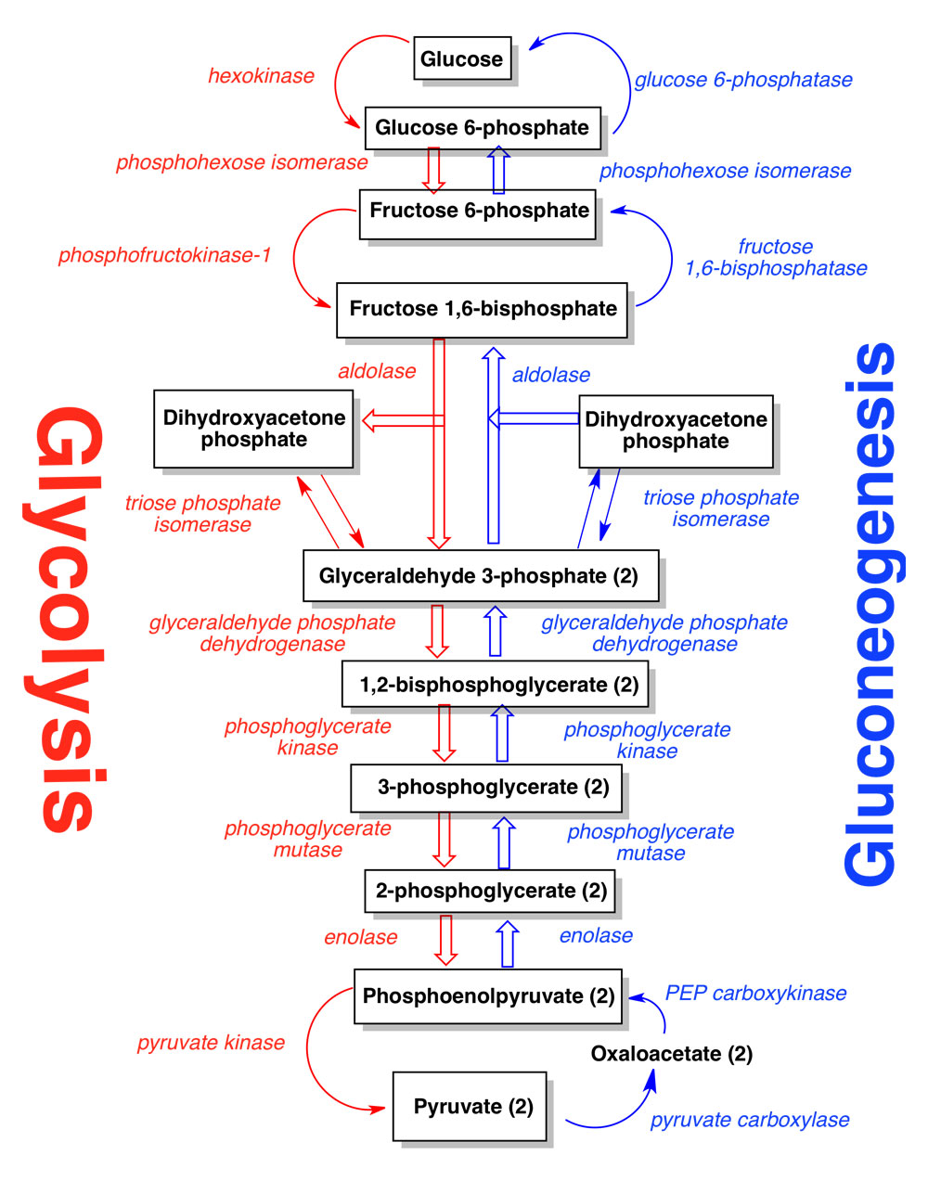
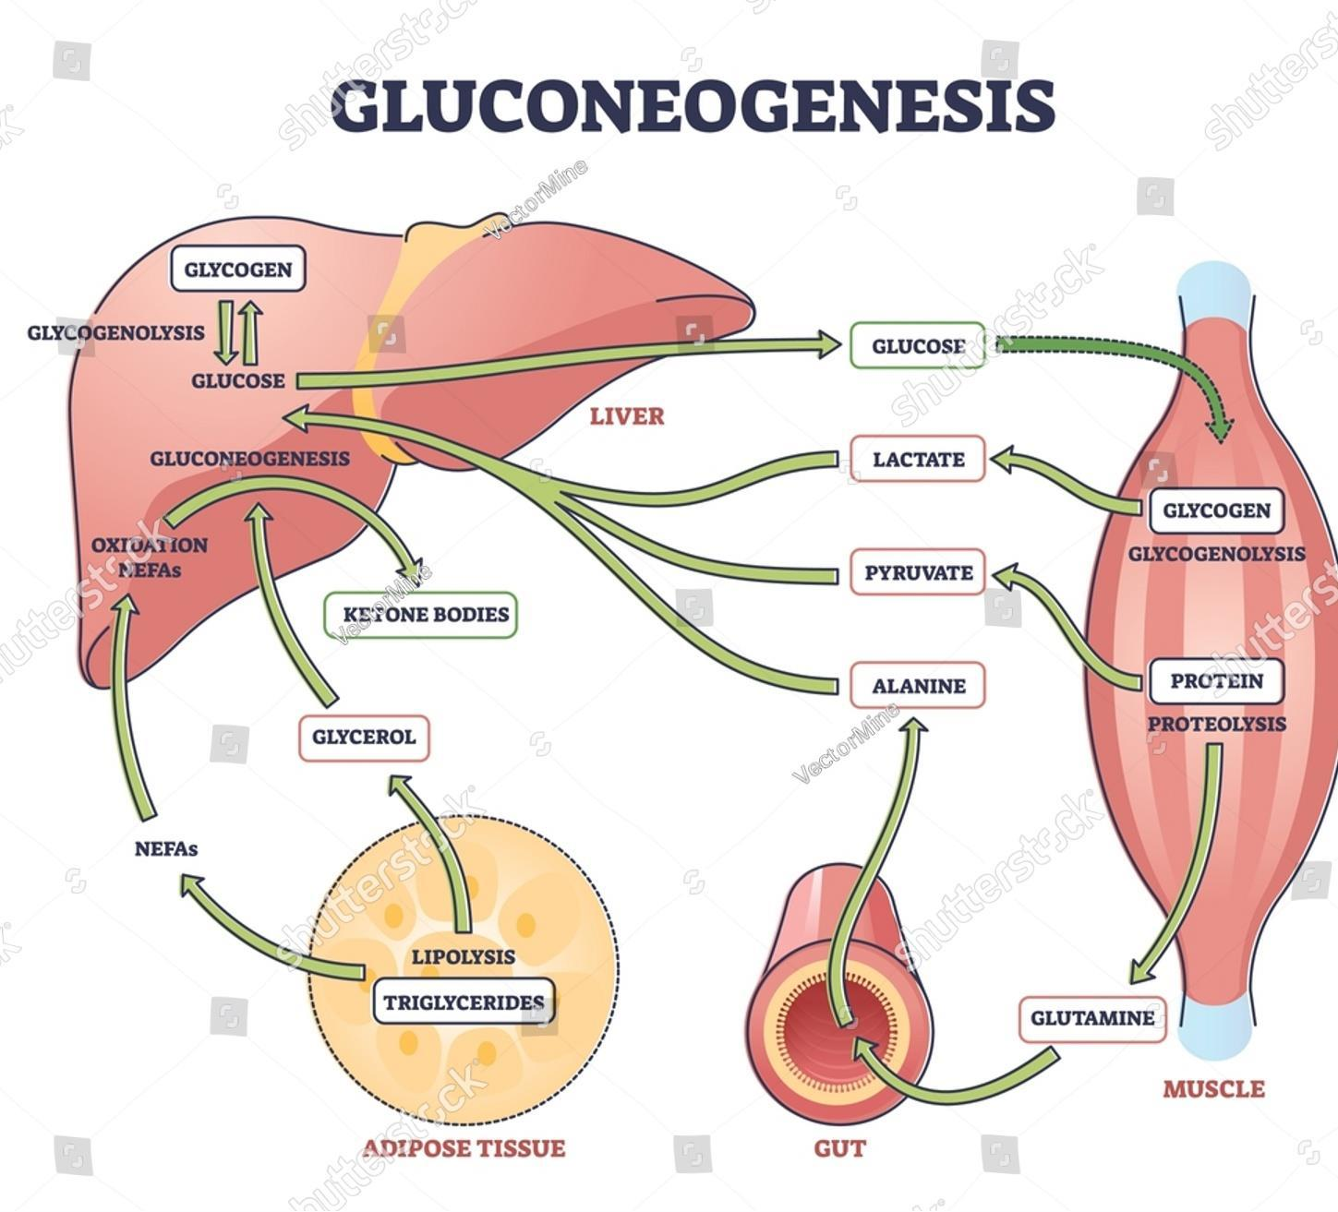


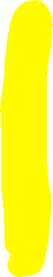



Slide 47
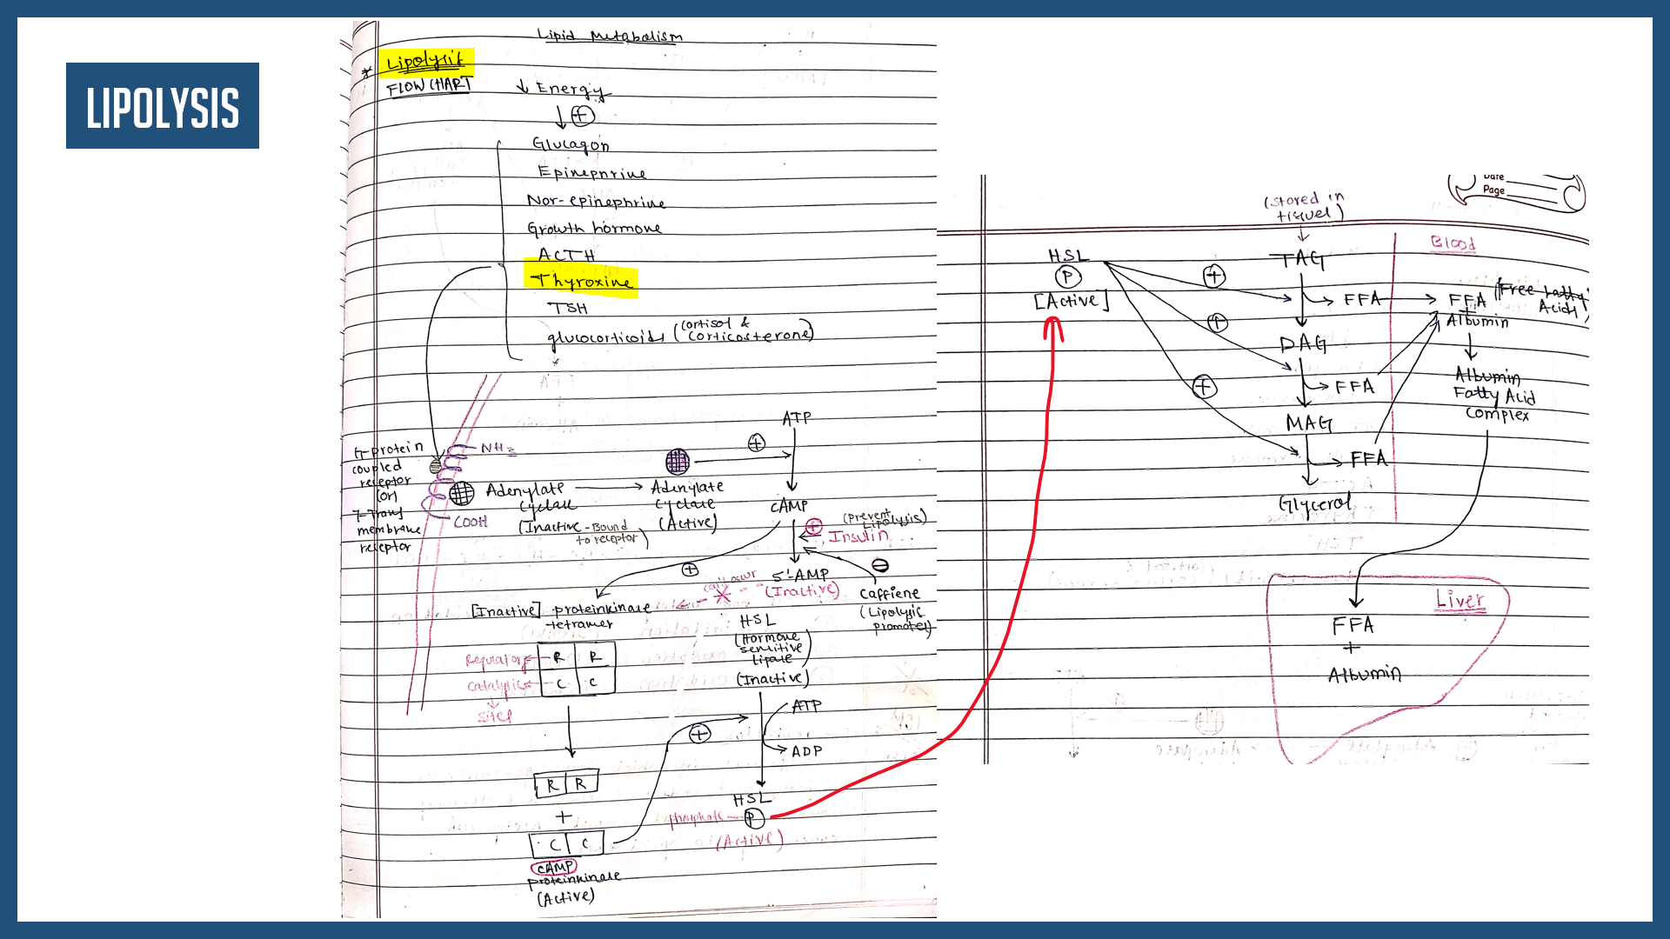





LIPOLYSIS

Slide 48



LIPOLYSIS

Slide 49


Slide 50



Slide 51


Slide 52


Slide 53


Slide 54

ANALYSIS OF signs & SYMPTOMS OF THYROID DISORDERS

Slide 55

Hypothyroidism
Hyperthyroidism
🧠 Nervous System
Fatigue and sluggishness
Depression or low mood
Impaired memory and concentration ("brain fog")
Slow reflexes
Sleepiness or excessive drowsiness
Peripheral neuropathy (tingling, numbness)
❤️ Cardiovascular System
Bradycardia (slow heart rate)
Cold intolerance
Mild hypertension (diastolic)
Pericardial effusion (in severe cases)
🧠 Nervous System
Anxiety, irritability, or restlessness
Tremors (especially in hands)
Insomnia or difficulty sleeping
Hyperactivity or agitation
Emotional lability (mood swings)
❤️ Cardiovascular System
Tachycardia (rapid heart rate)
Palpitations or irregular heartbeat (arrhythmia)
Increased systolic blood pressure
Warm and moist extremities due to vasodilation & Excessive sweating

Slide 56

Hypothyroidism
Hyperthyroidism
🫁 Respiratory System
Shortness of breath (especially on exertion)
Hypoventilation in severe cases
🍽️ Gastrointestinal System
Constipation
Reduced appetite
Weight gain (despite normal or reduced food intake)
🧍‍♀️ Musculoskeletal System
Muscle weakness
Cramps and stiffness
Joint pain or swelling
Delayed relaxation of deep tendon reflexes
🫁 Respiratory System
Shortness of breath (especially on exertion)
Increased respiratory rate (Tachypnea)
🍽️ Gastrointestinal System
Increased appetite & polyphagia
Weight loss despite normal or increased food intake
Frequent bowel movements or diarrhea
🧍‍♀️ Musculoskeletal System
Muscle weakness (especially proximal muscles like thighs)
Fatigue with exertion
Osteopenia or osteoporosis (in long-standing cases)

Slide 57



Slide 58

Hypothyroidism
Hyperthyroidism
🧬 Reproductive System
Irregular or heavy menstrual periods
Infertility or difficulty conceiving
Decreased libido
Menstrual cycle disturbances (amenorrhea or oligomenorrhea)
🧴 Integumentary System (Skin, Hair, Nails)
Dry, coarse, or scaly skin
Hair thinning or hair loss (including outer third of eyebrows)
Brittle nails
Puffy face - Myxedema
Pale or yellowish skin
🧬 Reproductive System
Irregular or scanty menstrual periods
Infertility
Gynecomastia in males (rare)
🧴 Integumentary System (Skin, Hair, Nails)
Warm, moist skin
Excessive sweating
Fine, brittle hair or hair loss
Flushing of the skin
Onycholysis (nail separation from nail bed)

Slide 59


ONYCHYLOSIS

Slide 60

Hypothyroidism
Hyperthyroidism
🗣️ ENT (Ear, Nose, Throat)
Hoarseness of voice
Enlarged tongue (macroglossia)
Hearing impairment (rare)
Puffy eyelids
🌡️ Metabolic and General
Cold intolerance
Weight gain
Low basal metabolic rate
Goiter (thyroid enlargement)
Myxedema (severe form with skin and tissue swelling)
Elevated cholesterol levels
🗣️ Ophthalmic and ENT
Exophthalmos (bulging eyes, especially in Graves’ disease)
Lid lag or stare
Dry or irritated eyes
Goiter (enlarged thyroid gland)
Hoarseness (if goiter compresses nearby structures)
🌡️ Metabolic and General
Heat intolerance
Weight loss
Low-grade fever
Increased basal metabolic rate
Fatigue despite hyperactivity
Increased thirst

Slide 61


Upper part of sclera visible

Slide 62


Slide 63

Intro to thyroid function tests

Slide 64

🧪 Thyroid Function Tests
T3 & T4 Assay: Measured via immunoassays (e.g., RIA, ELISA, CLIA); ↑ in hyperthyroidism, ↓ in hypothyroidism; secondary hypothyroidism shows ↓ T3, T4, and TSH.
Free T3 & T4: Only free hormones are biologically active; measured via sensitive ELISA; unaffected by binding protein levels.
Binding Proteins: Historically used to estimate hormone availability; now largely obsolete due to direct free hormone assays.
TSH (Plasma): ↑ in primary hypothyroidism (loss of feedback); ↓ in hyperthyroidism and secondary hypothyroidism (pituitary/hypothalamic dysfunction).
Antenatal TSH Screening: Used in pregnancy to screen for hypothyroidism and prevent congenital thyroid issues in the fetus.
TRH Stimulation Test:
Cholesterol: ↑ in hypothyroidism due to decreased lipoprotein clearance; not diagnostic but helpful for monitoring treatment.
Thyroid Antibodies:
Anti-TPO & anti-Tg: Marker of Hashimoto’s thyroiditis (hypothyroidism).
TSIg (stimulating) → Graves’ disease (hyperthyroidism).
TSHR-blocking Ab → Hypothyroidism; mixed antibodies may appear during treatment.
Serum Thyroglobulin: Monitored post-thyroidectomy in thyroid cancer patients to detect recurrence.

Slide 65

BIBLIOGRAPHY:
Textbook of Biochemistry for Med Students - DM Vasudevan, U Satyanarayana Biochemistry 4thEd, Guyton, Ganong
THANK YOU!

Slide 66


QUIZ TIME!

Slide 67
1. What is the primary mechanism of action of thyroid hormones at the cellular level?
A. Binding to cell surface receptors
B. Activation of G-protein coupled receptors
C. Binding to nuclear receptors and altering gene expression
D. Inhibition of enzyme activity
BY NAVNEETH V

Slide 68
1. What is the primary mechanism of action of thyroid hormones at the cellular level?
A. Binding to cell surface receptors
B. Activation of G-protein coupled receptors
C. Binding to nuclear receptors and altering gene expression
D. Inhibition of enzyme activity
✅ Answer: C. Binding to nuclear receptors and altering gene expression
🧠 Explanation: Thyroid hormones primarily act by altering gene transcription through nuclear receptors.
BY NAVNEETH V

Slide 69
2. What is the role of deiodinase enzymes in thyroid hormone action?
A. They synthesize thyroid hormones in the thyroid gland.
B. They convert inactive T4 into active T3 in target tissues.
C. They transport thyroid hormones in the bloodstream.
D. They inhibit thyroid hormone activity in tissues.
BY NAVNEETH V

Slide 70
2. What is the role of deiodinase enzymes in thyroid hormone action?
A. They synthesize thyroid hormones in the thyroid gland.
B. They convert inactive T4 into active T3 in target tissues.
C. They transport thyroid hormones in the bloodstream.
D. They inhibit thyroid hormone activity in tissues.
✅ Answer: B. They convert inactive T4 into active T3 in target tissues.
🧠 Explanation: Deiodinases activate T4 into T3, the more potent form, within peripheral tissues.
BY NAVNEETH V

Slide 71
3. Which of the following is a direct effect of thyroid hormones on tissues?
A. Increased glycogen synthesis
B. Increased protein degradation
C. Decreased oxygen consumption
D. Reduced lipid metabolism
BY NAVNEETH V

Slide 72
3. Which of the following is a direct effect of thyroid hormones on tissues?
A. Increased glycogen synthesis
B. Increased protein degradation
C. Decreased oxygen consumption
D. Reduced lipid metabolism
✅ Answer: B. Increased protein degradation
🧠 Explanation: Thyroid hormones increase metabolic activity, including protein degradation and oxygen use.
BY NAVNEETH V

Slide 73
4. Which thyroid hormone is more biologically active in tissues?
A. Thyroxine (T4)
B. Triiodothyronine (T3)
C. Reverse T3 (rT3)
D. Calcitonin
BY NAVNEETH V

Slide 74
4. Which thyroid hormone is more biologically active in tissues?
A. Thyroxine (T4)
B. Triiodothyronine (T3)
C. Reverse T3 (rT3)
D. Calcitonin
✅ Answer: B. Triiodothyronine (T3)
🧠 Explanation: T3 is the active form of thyroid hormone that binds to nuclear receptors and regulates gene expression, whereas T4 is a precursor.
BY NAVNEETH V

Slide 75

Biochemical Rationale and Interpretation of Lab Results in Hypothyroidism
Presented by
NIKHIL DEVISETTY

Slide 76

HYPOTHYROIDISM
DEFINITION
Hypothyroidism is a condition where the thyroid gland doesn't produce enough thyroid hormones to meet the body's needs.

Slide 77

Why should we do Biochemical Testing in Hypothyroidism?
Clinical symptoms are non-specific (fatigue, weight gain, etc.)
- Biochemical tests confirms hormonal imbalance
- Differentiates primary vs secondary vs subclinical causes

Slide 78

Thyroid Hormone Axis Overview
TRH (Hypothalamus) → TSH (Pituitary) → T3/T4 (Thyroid)
- Negative feedback regulates TRH & TSH
- Most T3 formed from peripheral conversion of T4

Slide 79

Core Biochemical Tests
Test Rationale
TSH Most sensitive marker of hypothyroidism
Free T4 Measures unbound active hormone
Free T3 Used for severity & atypical presentations
Anti-TPO Ab Suggests autoimmune etiology (Hashimoto’s)TRH stimulation Used when central causes are suspected

Slide 80

Interpretation – Primary Hypothyroidism
TSH: Elevated
Free T4: Low
Free T3: Often normal or low
Diagnosis: Thyroid gland failure

Slide 81

Interpretation – Central Hypothyroidism (Secondary/Tertiary)
TSH: Low or inappropriately normal
Free T4/T3: Low
Consider TRH stimulation & MRI of pituitary

Slide 82

Subclinical hypothyroidism
Subclinical hypothyroidism is a mild, early form of thyroid dysfunction where:-
TSH (thyroid-stimulating hormone) is elevated- But free T4 and T3 levels remain within the normal range.
It’s called “subclinical” because most people don’t have obvious symptoms, and the thyroid gland is still producing enough hormones to keep metabolism functioning normally

Slide 83

Interpretation –Subclinical Hypothyroidism
- TSH: Mildly elevated
- Free T4: Normal
- Often found incidentally
- Consider rechecking in 6–12 weeks

Slide 84
MCQ’S time
Q1. Which test is most sensitive for early hypothyroidism?
A. Free T3 B. Total T4 C. TSH D. TRH
✅ Answer: C
Q2. Low TSH + low T4 points to:
A. Primary hypothyroidism B. Tertiary hypothyroidism C. Pituitary failure D. Hashimoto’s
✅ Answer: C
Q3. Anti-TPO Ab positivity suggests:
A. Subclinical hypothyroidism B. Iodine excess C. Graves’ disease D. Autoimmune thyroiditis
✅ Answer: D

Slide 85


Slide 86


Slide 87


Slide 88


Slide 89


Slide 90


Slide 91


Slide 92


Slide 93


Slide 94


Slide 95


Slide 96


Slide 97


Slide 98


Slide 99


Slide 100


Slide 101


Slide 102


Slide 103
Which of the following is the most specific lab test to confirm Graves' disease? A. TSH B. Free T4 C. TSI (Thyroid-stimulating immunoglobulin) D. Anti-TPO antibody
✅ Answer: C. TSI

Slide 104
A 30-year-old female has ↓TSH, ↑T3/T4, ↑ESR, and low RAIU uptake. Most likely diagnosis? A. Graves’ disease. B. Toxic adenoma. C. Sub-acute thyroiditis D. Factitious thyrotoxicosis
✅ Answer: C. Subacute thyroiditis

Slide 105
↓TSH, ↑T3/T4, single hot nodule on RAIU scan. Diagnosis? A. Graves’ disease B. Toxic adenoma C. Thyroiditis D. Multinodular goitre
✅ Answer: B. Toxic adenoma

Slide 106
A patient presents with ↓TSH, ↑T3/T4, and diffuse high RAIU uptake. What is the most likely diagnosis? A. Subacute thyroiditis B. Graves’ disease C. Toxic adenoma D. Factitious thyrotoxicosis
✅ Answer: B. Graves’ disease

Slide 107


